Slide 1

MultiQA
An Empirical Investigation of Generalization and Transfer in Reading Comprehension
Alon Talmor and Jonathan Berant
Notes:
From the natural language processing ground in tel aviv university

Slide 2
Reading Comprehension (RC)
Hermann, 2015; Chen, 2016 ; Rajpurkar, 2016; Joshi, 2017; Wang, 2017; Jia and Liang, 2017;
What did Marilyn Monroe die from?
Marilyn Monroe was found dead of a barbiturate overdose in the early morning hours of Sunday, August 6, 1962, at her 12305 Fifth Helena Drive home in Los Angeles, California.
Answer: barbiturate overdose

Slide 3
RC is so many things!
SQuAD, NewsQA
Predicate/argument structure
TriviaQA, SearchQA
Quiz style question with larger contexts
HotpotQA, WikiHop ComplexWebQuestions
Multi-hop reasoning
DROP
Arithmetic reasoning
NarrativeQA
Narrative understanding
Notes:
Recently many new RC dataset have been introduced
How different are the tasks in this newly emerged RC Olympics.

Slide 4
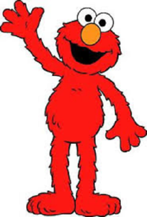
Desiderata
In this work we would like to test the generalization and transfer of models trained on these different datasets.
Questions of interest:
How does performance change when generalizing to new datasets?
Can fine-tuning on large RC datasets improve results on smaller datasets (even in the presence of )?

Slide 5
Contributions
An analysis of generalization and transfer on two popular RC models
A new multi-task model, MultiQA, that improves state-of-the-art on several datasets.
Infrastructure for easily performing experiments on multiple RC datasets.

Slide 6
Datasets
Dataset | Size | Context | Question | Multi-hop
SQuAD | 108K | Wikipedia | crowd | No
NewsQA | 120K | Newswire | crowd | No
SearchQA | 140K | Snippets | trivia | No
TriviaQA | 95K | Snippets | trivia | No
HotpotQA | 113K | Wikipedia | crowd | Yes
ComplexQuestions | 2K | Snippets | Web queries/KB | No
ComplexWebQuestions | 35K | Snippets | crowd/KB | Yes
ComQA | 11K | Snippets | WikiAnswers | No
WikiHop | 51K | Wikipedia | KB | Yes
DROP | 26K | Wikipedia | crowd | Yes

Slide 7
Models
We experiment with 2 RC models:
DocumentQA (Clark and Gardner, 2018)
BERT (Devlin et al., 2019)
end_span
end_span
start_span
start_span
BiDAF (Seo et al., 2016) + Self-attention
BERT
IR component
question
document1, document2 …
[cls] question [sep] context [sep]
Notes:
DocumentQA (Clark and Gardner, 2018)
Based on BiDaF (Seo et al., 2016)
Handling long contexts.
BERTQA (Devlin et al., 2019)
Pre-training of Deep Bidirectional Transformers
More layers (24)
Bidirectional
More data ( 7000 BooksCorpus + Wikipedia)
Input representation: [CLS] <question> [SEP] <chunk> [SEP]

Slide 8
Generalization Experiments

Slide 9
1. Do models generalize well?
Generalization
Document-QA
BERTQA
Evaluation
Evaluation
Training | CQ | CWQ | ComQA | WikiHop | DROP
SQuAD | 18 | 10.1 | 16.1 | 4.2 | 2.4
NewsQA | 14.9 | 8.2 | 13.5 | 4.8 | 3
SearchQA | 29.2 | 16.1 | 24.6 | 8.1 | 2.3
TriviaQA-Wiki | 24.6 | 14.5 | 17.9 | 8.4 | 2.9
HotpotQA | 24.6 | 14.9 | 21.2 | 8.5 | 7.7
Intra-Domain | 24.1 | 24.9 | 45.2 | 41.7 | 15.6
Training | CQ | CWQ | ComQA | WikiHop | DROP
SQuAD | 23.6 | 12 | 20 | 4.6 | 5.5
NewsQA | 24.1 | 12.4 | 18.9 | 7.1 | 4.4
SearchQA | 30.3 | 18.5 | 25.8 | 12.4 | 2.8
TriviaQA-Wiki | 30.3 | 16.5 | 23.6 | 12.6 | 5.1
HotpotQA | 27.7 | 15.5 | 22.1 | 10.2 | 9.1
Intra-Domain | 30.8 | 27.1 | 51.6 | 52.9 | 17.9
Average: 12.8EM
Average: 15.8EM
BERT → WikiHop > Evaluate on WIkiHop
Average: 30.3EM
Average: 36.1EM
BERTQA improves generalization compared to DocumentQA.
The finding confirms that models over-fit to the particular dataset and generalize poorly.
Notes:
BERTQA improves generalization by 21.2% on average compared to
DOCQA.
performance reduction of 31.5% from Self. confirms the finding that models over-fit to the particular dataset
From now on we will only talk about BERT

Slide 10
2. Does generalization improve when training on multiple datasets?
Generalization
Evaluation
Training | CQ | CWQ | ComQA | WikiHop | DROP
SQuAD | 23.6 | 12 | 20 | 4.6 | 5.5
NewsQA | 24.1 | 12.4 | 18.9 | 7.1 | 4.4
SearchQA | 30.3 | 18.5 | 25.8 | 12.4 | 2.8
TriviaQA-Wiki | 30.3 | 16.5 | 23.6 | 12.6 | 5.1
HotpotQA | 27.7 | 15.5 | 22.1 | 10.2 | 9.1
Multi-75K | 34 | 18.2 | 30.9 | 11.7 | 8.6
MULTI-75K performs almost as well as the best single training dataset, reducing the need for selecting a single training set
Notes:
BERTQA improves generalization by 21.2% on average compared to
DOCQA.
performance reduction of 31.5% from Self. confirms the finding that models over-fit to the particular dataset

Slide 11
3. Does generalization improve when training on more data?
Generalization
More training data improves generalization.

Slide 12
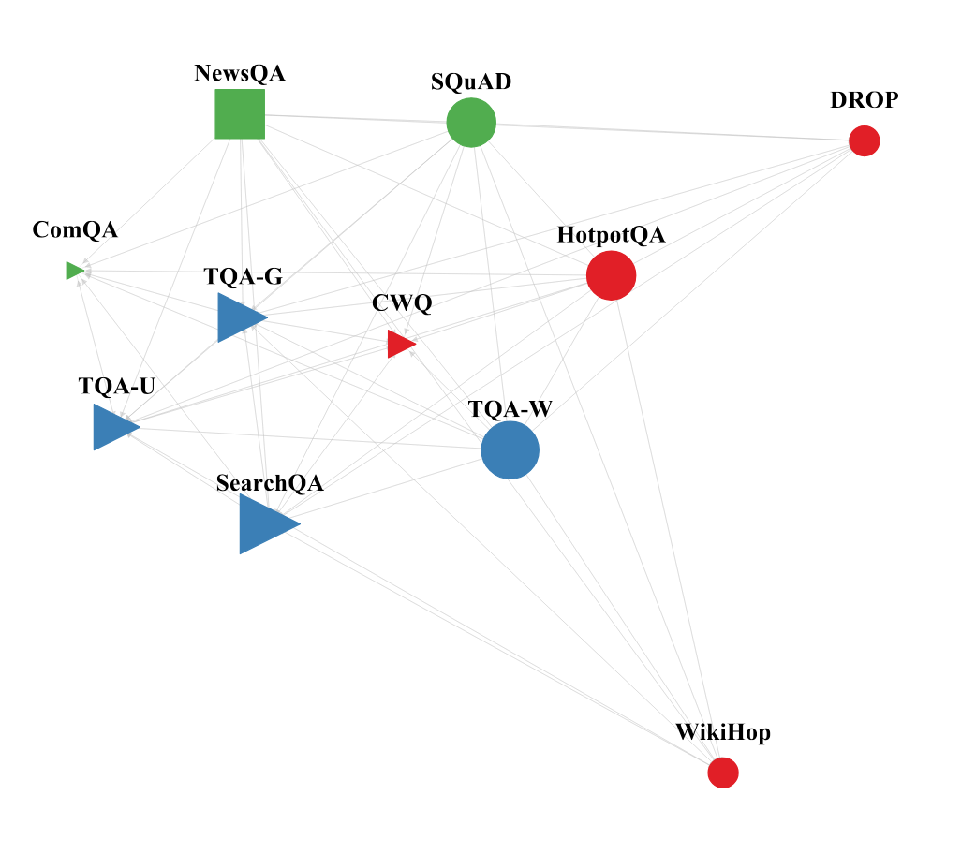
A 2D-visualization of the similarity between different datasets
Generalization
Datasets with similar context types are closer in terms of generalization
Single Edge: BERT → NewsQA > WikiHop
 | CQ | CWQ | ComQA | WikiHop | DROP | SQuAD | NewsQA | SearchQA | TriviaQA-G | TriviaQA-Wiki | HotpotQA
SQuAD | 23.6 | 12 | 20 | 4.6 | 5.5 | - | 31.8 | 8.4 | 37.8 | 33.4 | 11.8
NewsQA | 24.1 | 12.4 | 18.9 | 7.1 | 4.4 | 60.4 | - | 10.1 | 37.6 | 28.4 | 8
SearchQA | 30.3 | 18.5 | 25.8 | 12.4 | 2.8 | 23.3 | 12.7 | - | 53.2 | 35.4 | 5.2
TriviaQA-G | 35.4 | 19.7 | 28.6 | 6.3 | 3.6 | 36.3 | 18.8 | 39.2 | - | - | 8.8
TriviaQA-Wiki | 30.3 | 16.5 | 23.6 | 12.6 | 5.1 | 35.5 | 19.4 | 27.8 | - | - | 8.7
HotpotQA | 27.7 | 15.5 | 22.1 | 10.2 | 9.1 | 54.5 | 25.6 | 19.6 | 37.3 | 34.9 | -
Datasets with similar tasks are closer in terms of generalization
Context type (shape)
  Triangles: Web snippets
  Circles: Wikipedia
  Squares: Newswire
Task characteristics (color)
  Red: Multi-hop reasoning datasets
  Blue: Trivia datasets
  Green: Factoid RC datasets
Notes:
The metric distance is the distance between the

Slide 13
4.Can we improve results with context augmentation?
Training | TriviaQA-G | TriviaQA-Unfiltered | TriviaQA-Wiki
TriviaQA-G | 60.7 | 53.6 | 43.3
TriviaQA-unfiltered | 57.2 | 53.1 | 39.9
TriviaQA-Wiki | 48.4 | 44.6 | 50.1
Context-Mix | 67.7 | 54.4 | 54.7
Single TriviaQA Question
Google
context
Bing
Context
Wikipedia
Context
Results improve when augmenting only contexts.

Slide 14
Transfer Experiments

Slide 15
5. Can additional fine-tuning improve results on small datasets even in the presence of BERT
Transfer
Source | SQuAD | NewsQA | SearchQA | TriviaQA-Wiki | HotpotQA
SQuAD | - | 41.2 | 47.8 | 45.4 | 20.8
NewsQA | 72.1 | - | 47.4 | 45.2 | 20.6
SearchQA | 70.2 | 40.2 | - | 45.5 | 20.4
TriviaQA-Wiki | 71 | 39.2 | 48.4 | - | 20.9
HotpotQA | 71.2 | 39.5 | 48.6 | 45.6 | -
Only Target (15K) | 70.1 | 37.9 | 46 | 41.9 | 18.9
Target
Average: 45.1EM
BERT → SearchQA → TriviaQA-Wiki (15K)
BERT → TriviaQA-Wiki (15K)
Average: 42.9EM
15K examples from the target can overcome the generalization gap
Fine tuning order: BERT → Source (75K) → Target (15K)
Additional fine-tuning on a related RC dataset helps even in the presence of BERT
Notes:
* pre-training on a related RC dataset helps even given representations from a model like BERTQA
* small amounts of data from the target distribution can overcome the generalization gap
*
In 4 datasets (COMQA, DROP, HOTPOTQA, WIKIHOP) the best source dataset uses web snippets in DOCQA, but Wikipedia in BERTQA.
* MULTI-75K obtains good performance in almost all setups
Add Related Work

Slide 16
I have a small dataset, how do I chose the right dataset to pre-train on?
Is performance in the generalization setup predictive of performance in the transfer setup?
  AVR performance when choosing the best source dataset: 39.3 DocQA and 43.8 BERTQA
  AVR performance when choosing the source dataset from generalization: 38.9 DocQA and 43.5 BERTQA
However, training on a mix (MultiQA) also yields good results without selecting a source dataset at all.

Slide 17
6. How much target data do we really need?
Transfer
Source: SearchQA, Target: TriviaQA-Bing
Source: SQuAD, Target: HotpotQA
Source → Target
95%
Only Target
EM Accuracy
EM Accuracy
, compared to 86% with only target training.
Number of target examples
Number of target examples
With 2 step fine-tuning we only need 49% target data
We can save costs by performing a 2 step fine-tuning
Notes:
Learning curves for the five large datasets (top is DOCQA and bottom is BERTQA). X-axis: number of examples from the target dataset, Y-axis:EM. Orange: training on the target dataset only :pre-training on 75K examples from the nearest source dataset and fine-tuning on the target dataset. The green curve is training on a fixed number of examples from all 5 large datasets without fine-tuning (MULTIQA)
Can we save costs?
* * Green – pre-training on multiple dataset: we reach 95% of the final performance using 30% of the examples only
* In 5 out of 10 curves, pre-training improves performance even given access to all 75K examples from the target dataset

Slide 18
7. What if we use multiple datasets as source?
Transfer
Target: TriviaQA-unfiltered
Target: NewsQA
multi-source → Target
EM Accuracy
Source → Target
EM Accuracy
Only Target
Number of target examples
Number of target examples
Multi-source training is improves accuracy
Notes:
Learning curves for the five large datasets (top is DOCQA and bottom is BERTQA). X-axis: number of examples from the target dataset, Y-axis:EM. Orange: training on the target dataset only :pre-training on 75K examples from the nearest source dataset and fine-tuning on the target dataset. The green curve is training on a fixed number of examples from all 5 large datasets without fine-tuning (MULTIQA)
Can we save costs?
* * Green – pre-training on multiple dataset: we reach 95% of the final performance using 30% of the examples only
* In 5 out of 10 curves, pre-training improves performance even given access to all 75K examples from the target dataset

Slide 19
MultiQA – state of the art
MultiQA: Training BERTLarge on SQuAD, NewsQA, HotpotQA, TriviaQA-Bing, SearchQA
 | BERT-large Dev. |  | MultiQA Dev. |  | MultiQA Test. |  | SOTA
 | EM | tok. F1 | EM | tok. F1 | EM | tok. F1 | EM | tok. F1
NewsQA | 51.5 | 66.2 | 53.9 | 68.2 | 52.3 | 67.4 | 53.1 | 66.3
SearchQA | 59.2 | 66.4 | 60.7 | 67.1 | 59 | 65.1 | 58.8 | 64.5
TriviaQA-unfiltered | 56.8 | 62.6 | 58.4 | 64.3 | - | - | 52 | 61.7
CWQ | 30.8 | - | 35.4 | - | 34.9 | - | 34.2 | -
HotpotQA | 27.9 | 37.7 | 30.6 | 40.3 | 30.7 | 40.2 | 37.1 | 48.9

Slide 20
Does multi-dataset training help adversarial attacks?
Transfer
Notes:
We evaluated MultiQA on the adversarial Squad (Jia and Liang, 2017) where a misleading sentence is appended to each context
We evaluated MultiQA on the adversarial Squad (Jia and Liang, 2017)
MultiQA obtained 66.7 EM and 73.1 F1, outperforming BERT-large (60.4EM, 66.3F1) by a significant margin,
Also substantially improving state-of-the-art results (53.0 EM, 58.5 F1, Hu et al., 2018)

Slide 21
Take-Aways
Generalization
BERTQA improves generalization over DocumentQA, but both models generalize poorly
Using multi distribution training reduces the need for selecting a single training-set
More training data improves generalization
Context augmentation improve results.
Datasets with similar tasks or contexts are closer in terms of generalization
Transfer
Fine tuning on a small number of target examples can overcome the generalization gap
Additional fine-tuning on a related RC dataset helps even in the presence of BERT
We can save costs by performing a 2 step fine-tuning
Training on multiple datasets (MultiQA) consistently improve over BERT in several benchmarks and adversarial attacks
Notes:
but their effect is moderate when the source of the context is not Wikipedia.

Slide 22
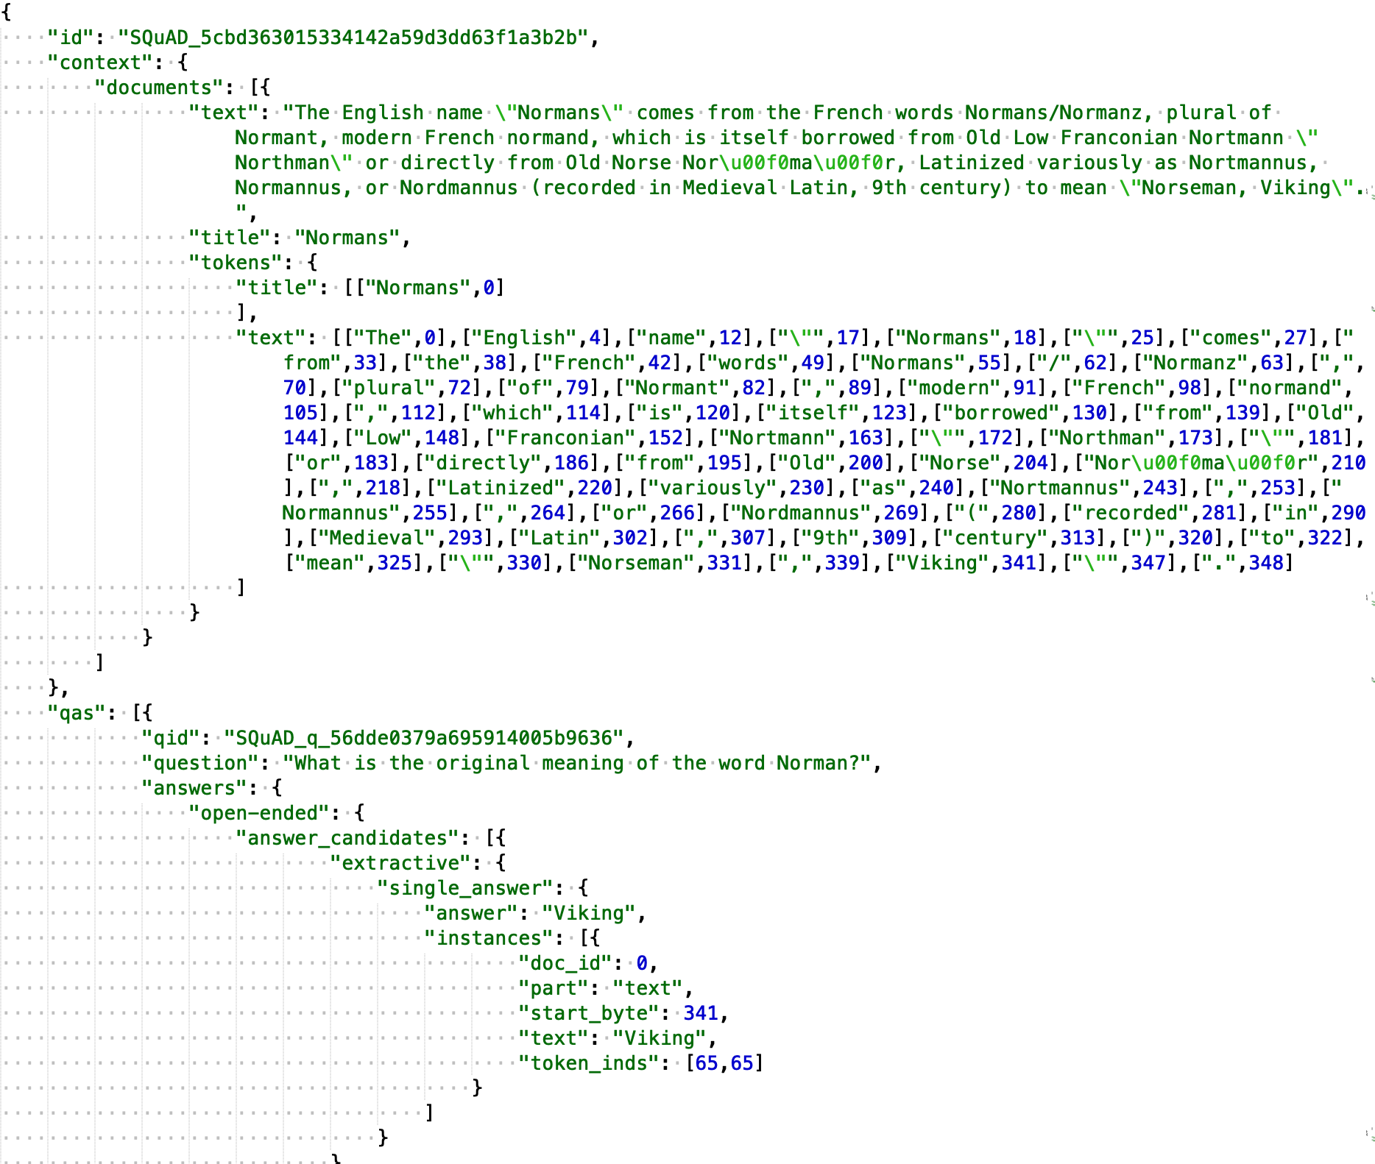
The MultiQA Project – Unified format for datasets
github.com/alontalmor/multiqa
Single format for all RC datasets
Expressive answer types supporting
  yes/no
  cannot-answer
  list answers
  multi-choice
Supports Multi-Document contexts
Contexts are tokenized

Slide 23
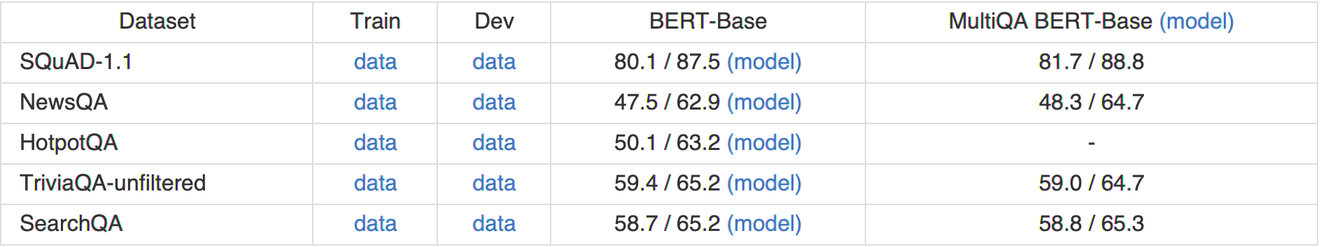
The MultiQA Project – models use AllenNLP
github.com/alontalmor/multiqa
  python multiqa.py train –datasets TriviaQA,SQuAD1-1,HotpotQA
  Python multiqa.py evaluate –model TriviaQA –datasets SQuAD1-1,HotpotQA
  Python multiqa.py generalize –datasets TriviaQA,SQuAD1-1,HotpotQA

Slide 24
  Thanks! Questions?
github.com/alontalmor/multiqa

